Slide 1
Tic-Tac-Toe Game

Slide 2
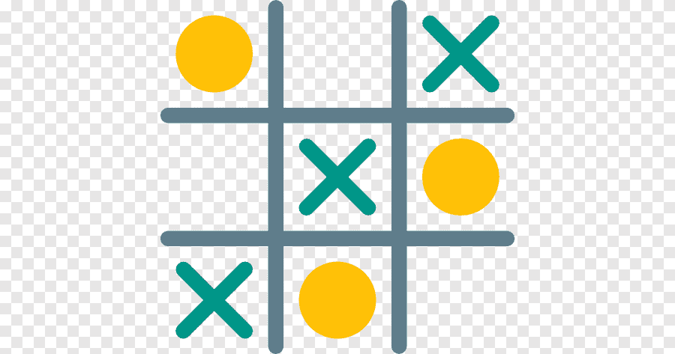
Tic-Tac-Toe Game

Slide 3
Description
Allow for user to choose the size of the game such as 3x3, 4x4, or 5x5 .
Have one player and two players .
Can play with computer [1 player] .
Can play with your friends [2 player].
player X is a frist player , player O is a second player.

Slide 4
Description
You can control the background color of the game.
You can control the color of X and O .
Added a score card for both players for a session .
You can test in firefox and chrome .

Slide 5
Names of Team
Section 3 IS ...
1 - Mohammed Radi Abdul Qader Mohammed (level 4 2016).
2 - Hossam Hassan Farouk (level 4 2016) .
3 - Amr Ragab Nassim .
4 - Omar Fathi Salah .
5 - Omar Jamal Mohammed .

